Slide 1
Network basics

Slide 2
Books and reference material
B. Forouzan, Introduction to Data Communications and Networking, 5th Edition, Tata McGraw-Hill Publishing Company Ltd., New Delhi, 2004
William Stallings, Data and Computer Communications
Andrew Tanenebaum - Computer Networks
Kurose and Ross – Computer Networking: A top-down approach

Slide 3


Slide 4
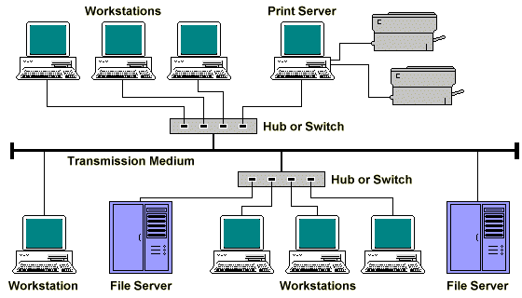
Networks

Slide 5
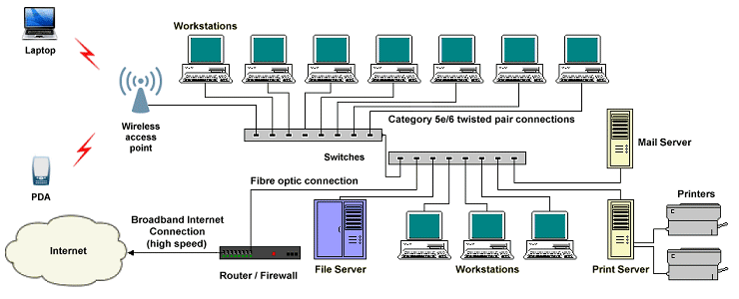
Networks

Slide 6
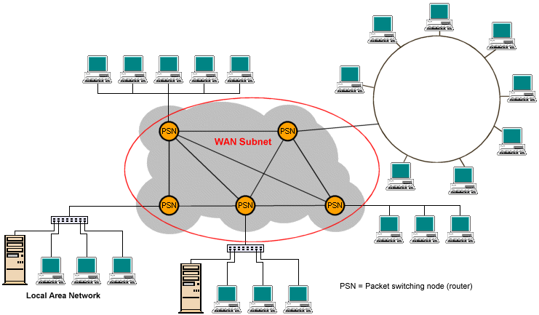
Networks

Slide 7
Network Model
Internet model (TCP/IP)
ISO –OSI Reference model

Slide 8
Layered model
Letter is written, Put in envelope, dropped in mailbox
Higher Layers
Letter is picked up, removed from envelope and read
Letter is carried from mail box to the post office
Letter is carried from post office to mail box
Middle Layers
Letter is delivered to the carrier by the post office
Lower Layers
Letter is delivered from carrier to the post office
Parcel is carried from source to destination

Slide 9

ISO/OSI model
ISO –
OSI – Open System Interconnection model
This is model not a protocol
It covers all aspect of network communication

Slide 10
Study of layered model means study of their
Functions
Scope ( delivery points)
Delivery points
Hop to hop ( node to node)
Source to destination (end to end delivery)
Process to process (port to port)

Slide 11
The seven layered model
Application
Presentation
Session
Transport
Network
Data link
Physical

Slide 12
The process of breaking up the functions or tasks of networking into layers reduces complexity.
Each layer provides a service to the layer above it in the protocol specification.
Each layer communicates with the same layer’s software or hardware on other computers.

Slide 13
OSI layers
H7
D7
H7
D7
H6
D6
H6
D6
H5
D5
H5
D5
H4
D4
H4
D4
H3
D3
H3
D3
H2
D2
T2
H2
D2
T2
010
0110010101010101010101111
010
0110010101010101010101111

Slide 14
Physical Layer
Physical characteristics of i/fs & media
Representation of bits
Data rates (transmission rate)
Synchronization of bits
Line Configuration (Dedicated or shared)
Physical Topology
Transmission mode (simplex, Half/Full Duplex)

Slide 15
Data link layer
Data link layer is responsible for moving FRAMES from one Hop (Node) to the next. i.e. Hop- to- Hop delivery

Slide 16
Data link layer
Framing
Physical Addressing
Flow control
Error control
Access control

Slide 17
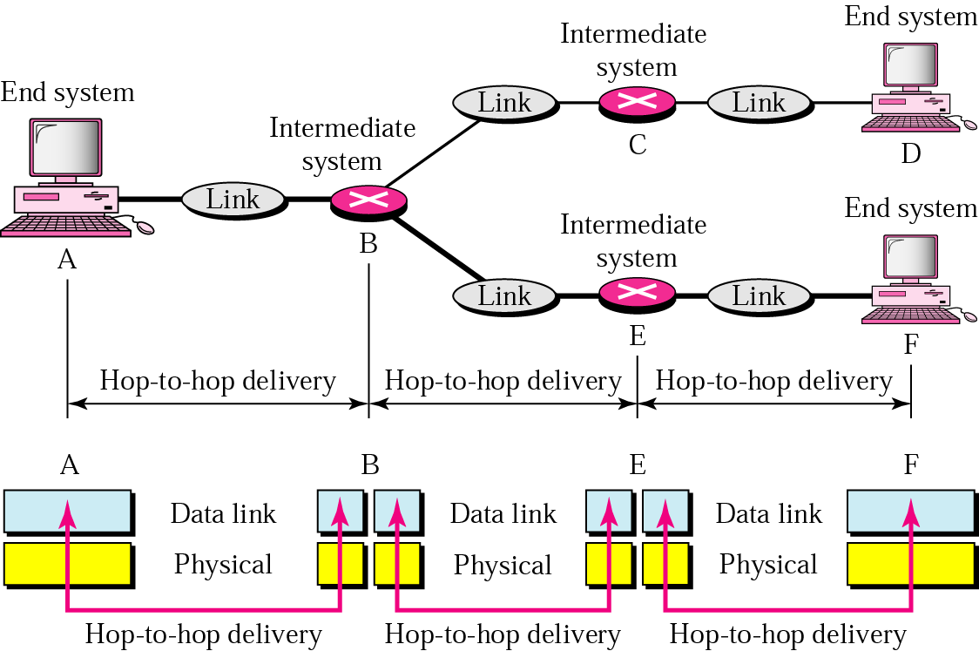
Hop-to-Hop delivery

Slide 18
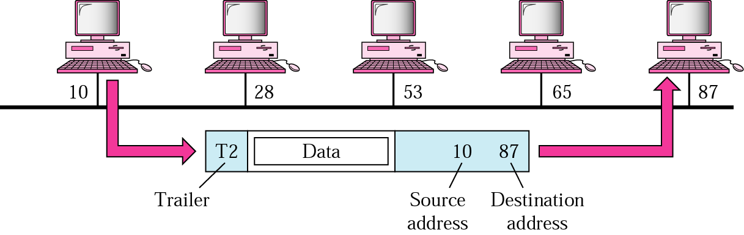
At data link layer…

Slide 19
Network Layer
Which path to take?
Why?
How to proceed?
ROUTING

Slide 20
Network Layer
Network layer is responsible for the delivery of individual PACKETS from source to destination

Slide 21
Functions of Network Layer
Logical Addressing
Routing

Slide 22
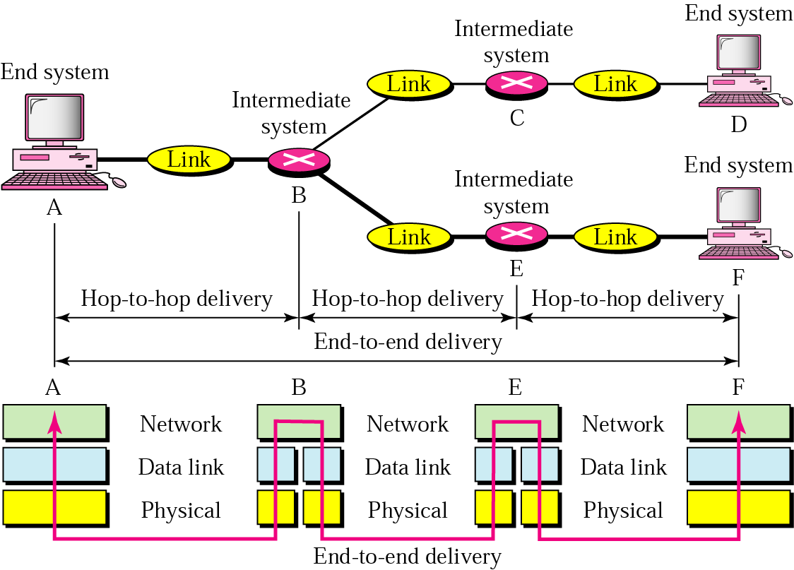
Network Layer

Slide 23
A
B
C
D
10
51
60
24
66
E
A
P
10
66
95
F
A
P
12
G
56
H
95
56
P
A
52
I
54
52
54
80
34
19
L
P
N
M

Slide 24
Transport Layer
Transport layer is responsible for delivery of message from one process to another.

Slide 25

Transport Layer
Ma
i
l
M
A
I
L
FTP
S
E
R
V
E
R
PROCESS TO PROCESS OR
PORT TO PORT DELEVERY

Slide 26
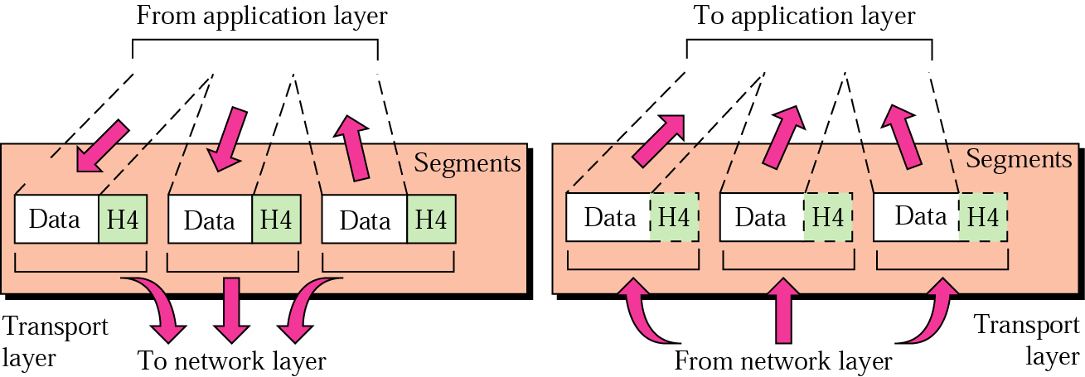
Transport Layer

Slide 27
Transport Layer
Process to process delivery – it requires service point address i.e port addresses
What are port addresses?
Port number 20 –FTP DATA
Port number 23 – TELNET
Port number 25 – SMTP
Port number 80 – HTTP

Slide 28
Functions of transport layer
Service point addressing
Segmentation and reassembly
Flow control
Error control
Connection control

Slide 29
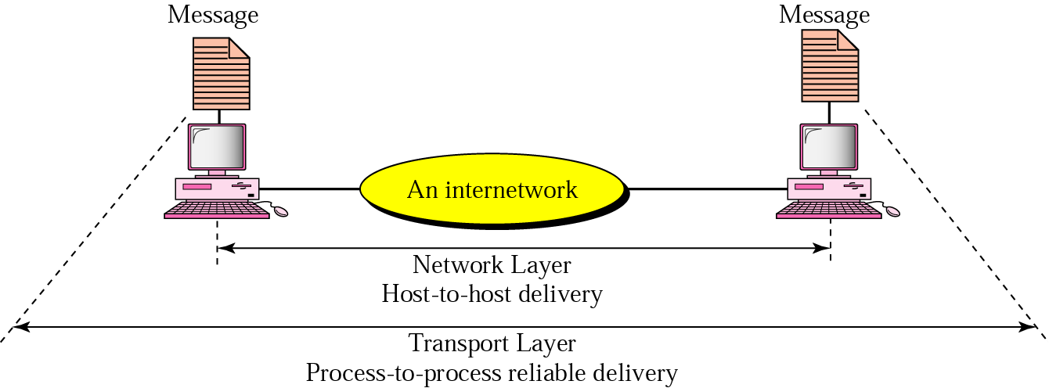
Transport Layer

Slide 30
SESSION LAYER
To establish, manage and terminate session
Examples
login
Password validation
So, functions like Dialog control
Synchronization

Slide 31
PRESENTATION LAYER
Sender or receiver may be using different syntax, semantics for information
Hence, message from above (appl layer) is transferred to common format at sender’s side and converted to receiver’s required format at his side using corresponding presentation layers.
So, functions like translation, compression, encryption

Slide 32
APPLICATION LAYER
It enables user/software to access network
Internet browser –
( Internet Explorer / Mozilla Firefox)
SEND/ RECEIVE MAIL
DOWNLOAD
TELNET
SURF
TELNET
HTTP
SMTP
FTP

Slide 33
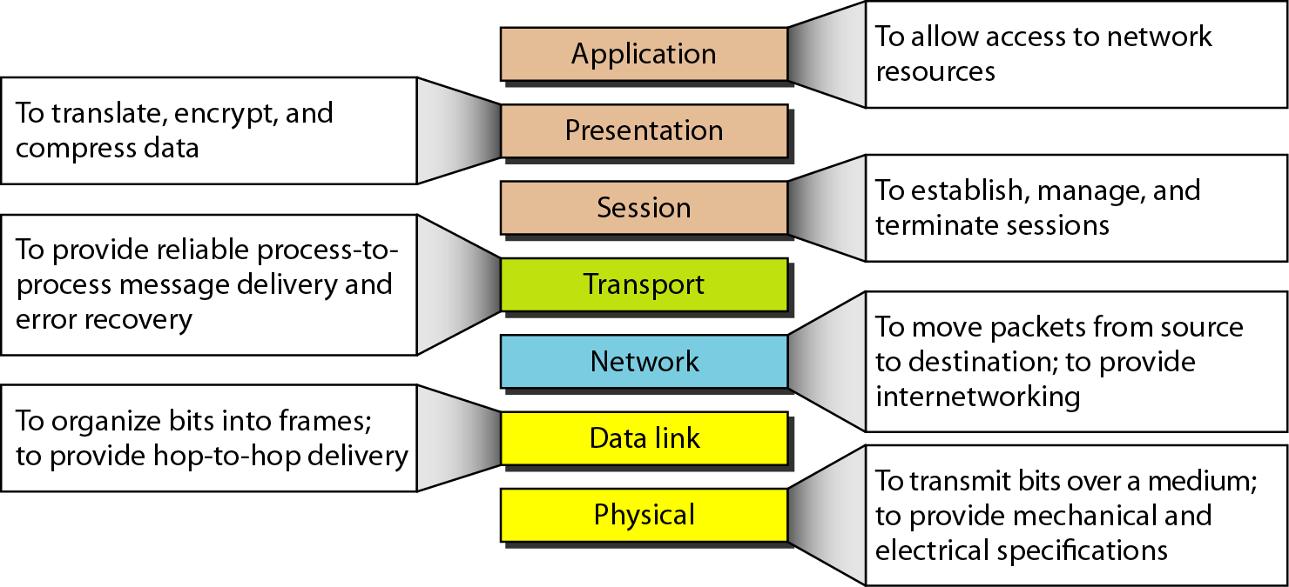
Summary

Slide 34
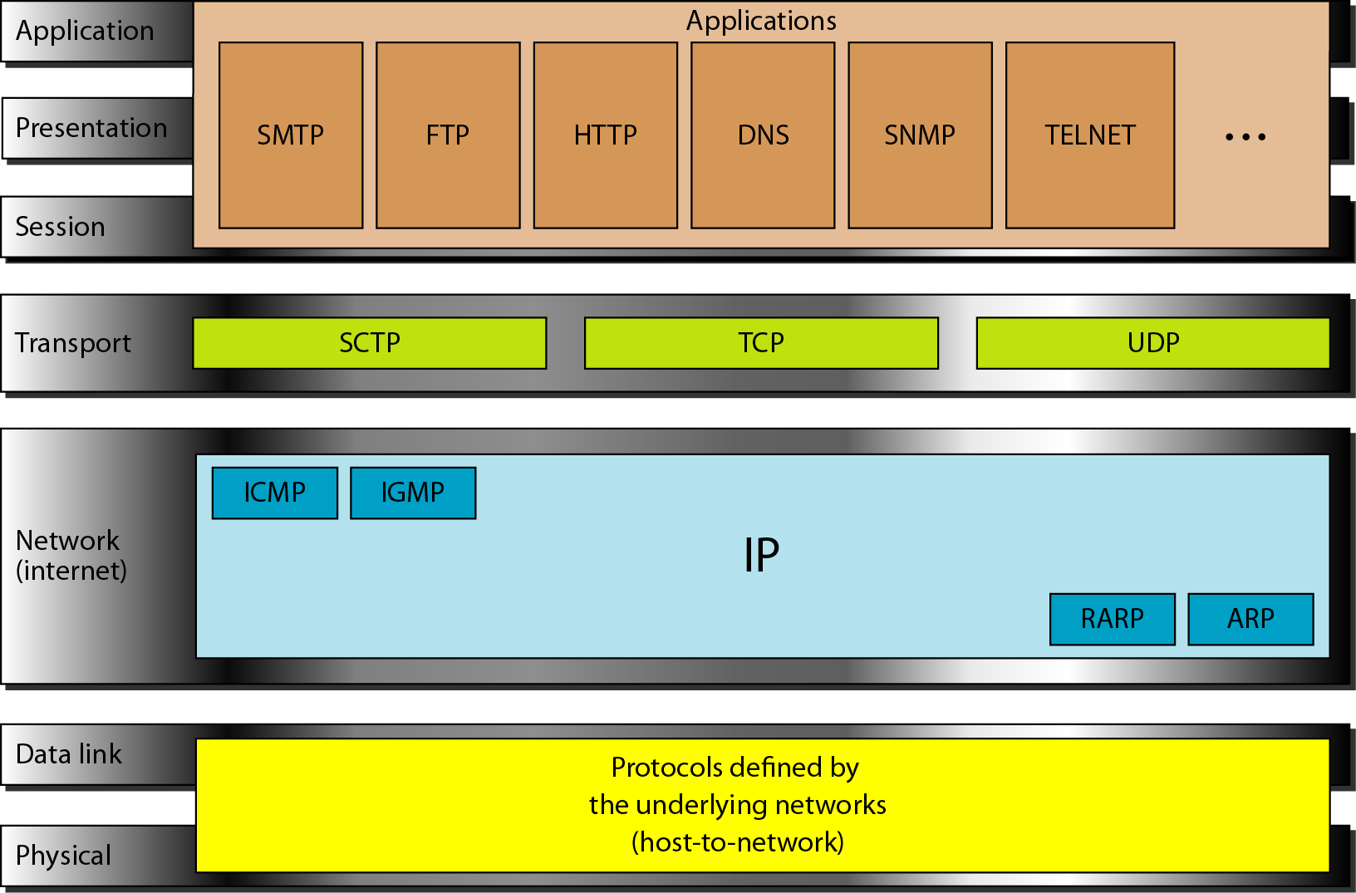
TCP/IP and OSI comparison

Slide 35
Application
Application
Presentation
Session
Transport
Transport
Network
Network
Data link
Data link
Physical
Physical

Slide 36
Application
Application
Presentation
Session
Transport
Transport
Network
Network
Data link
Data link
Physical
Physical

Slide 37
Internet Protocol (IP)
Transmission mechanism
Unreliable, connectionless
Best-Effort delivery
No error checking, tracking
No track of routes
No reassembly of datagrams at destination
Will do best to get the transmission through, but no guarantees

Slide 38
Other protocols
ARP (Address Resolution Protocol)
RARP(Reverse Address Resolution Protocol)
ICMP (Internet Control Message Protocol)
IGMP (Internet Group Message Protocol)
Logical address
Physical address
Physical address
Logical address

Slide 39
Transport Layer
TCP (Transmission Control Protocol)
UDP(User Datagram Protocol)
SCTP (Stream Control Transmission Protocol)

Slide 40
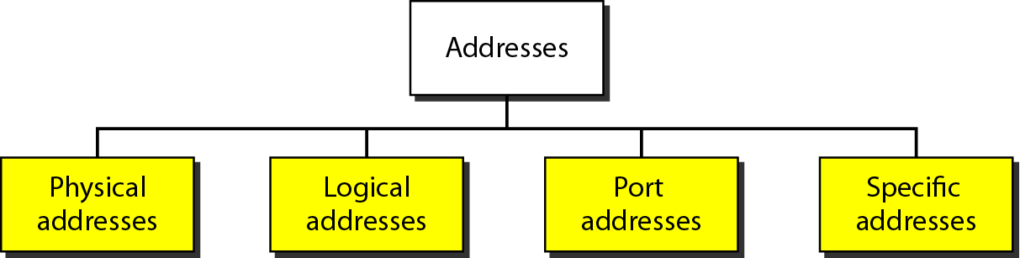
Addresses in TCP/IP

Slide 41
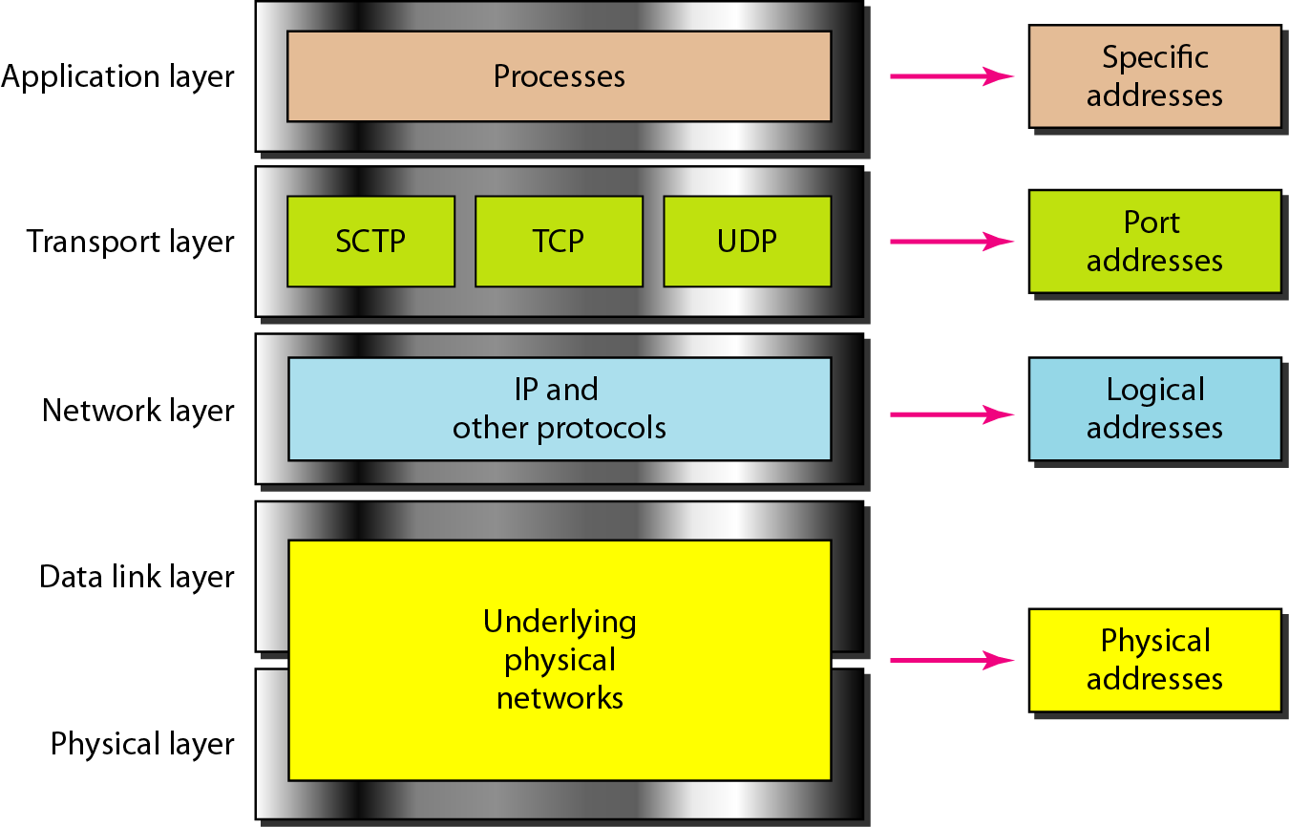
Relationship

